Slide 1
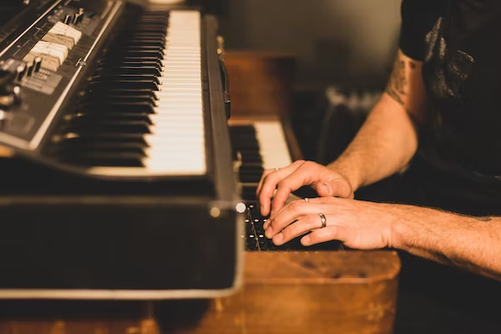
You are not your own

Slide 2
You are not your own
Genesis 1: 26-30
Dominion
Dependence
We are “limited conquerors”

Slide 3
I want to be my own
Genesis 3:
“You shall be like God”

Slide 4
We are stuck being our own
“My people have committed two sins: They have forsaken me, the spring of living water, and have dug their own cisterns, broken cisterns that cannot hold water”
Jeremiah 2:13

Slide 5
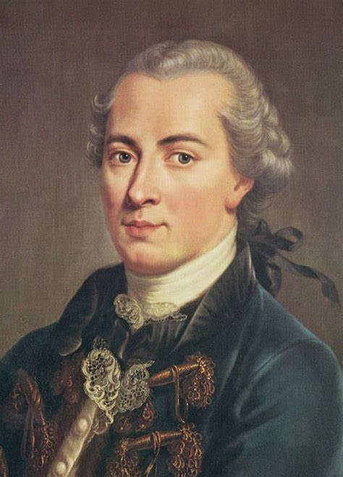
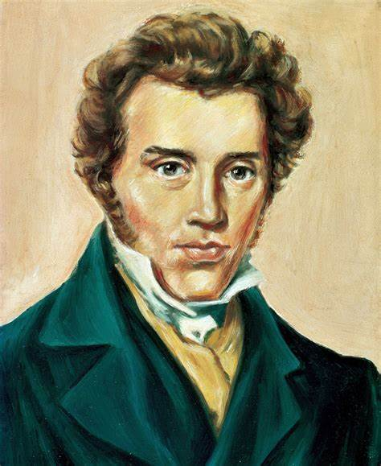
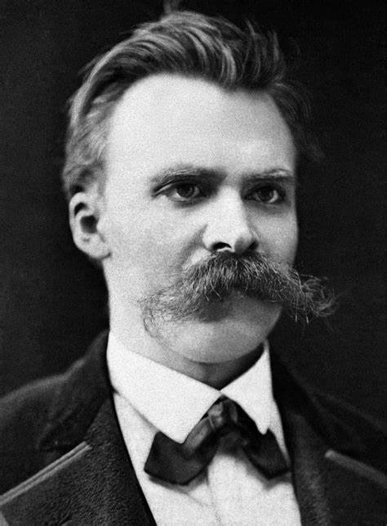
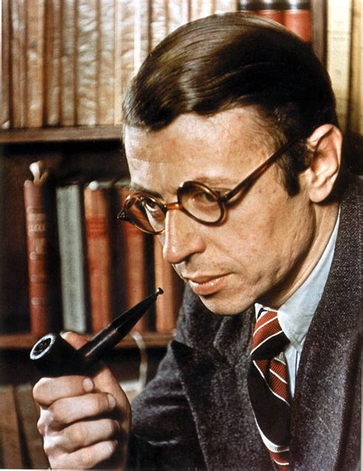
We think it’s great to be our own

Slide 6
It’s hard being our own
The burden of self justification
The weariness of myself

Slide 7
Society is about helping us be our own
Affirmation
Resignation

Slide 8
But we are not our own
What is your only comfort in life and in death?
A. That I am not my own, but belong—
body and soul, in life and in death—
to my faithful Saviour, Jesus Christ

Slide 9
But we are not our own
¹⁹ Do you not know that your bodies are temples of the Holy Spirit, who is in you, whom you have received from God? You are not your own; you were bought at a price. Therefore honour God with your bodies.
1 Corinthians 6

Slide 10
But we are not our own
^{A belonging, limited, life}

